Slide 1
Space Invaders
Yan Konichshev and Luka Salkovic
Introduction to Computer Science - Spring 2022

Slide 2
About the game
Our game will be similar to the famous Space Invaders arcade game
Enemies/aliens will be moving from top to bottom and shooting bullets at the player (player = the shooter)
In case the player is hit one life is deducted from the lives count
Objective of the game is to destroy them before they reach the bottom or kill the player which happens in case the player losses all of his lives
Enemies will appear in groups with the number of them varying according to the level achieved by the player. The player passes one level by killing all the enemies. After certain levels being passed -we are thinking of 10 levels- the boss of the game is being generated
In the end of the game - the rating of the game played is being displayed. The rating is a calculation of the score per time unit + certain points that are added after you pass the certain level (formula is a subject to change)

Slide 3
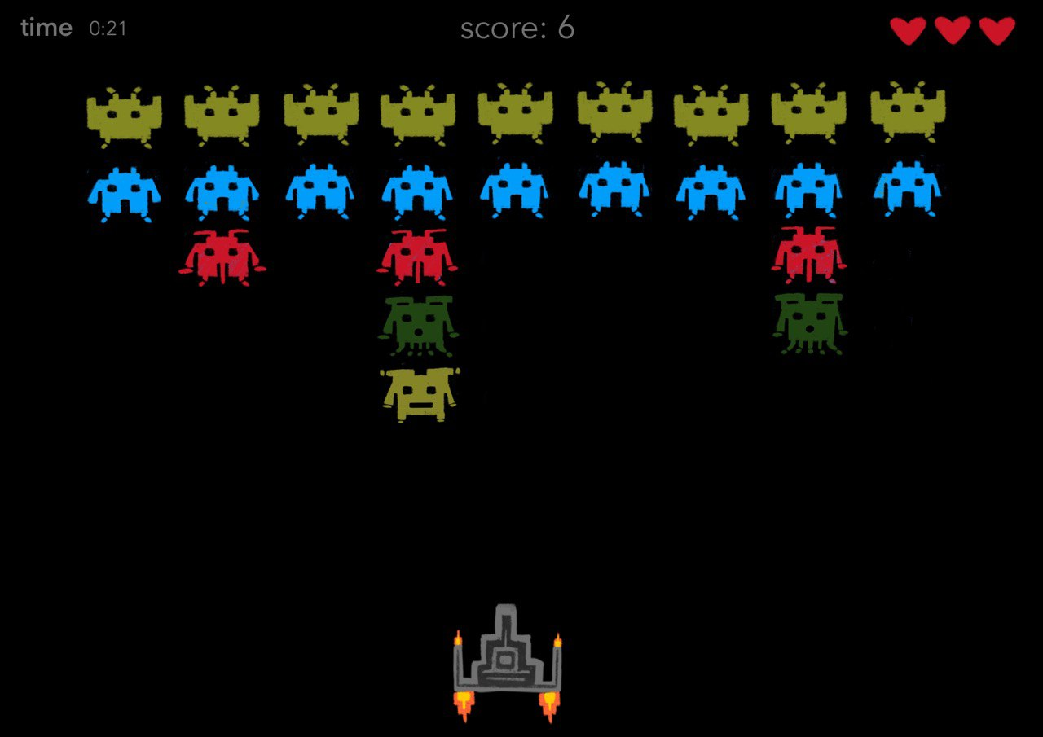
Demo version of the game
https://freeinvaders.org/ - link for the game simulation online

Slide 4
Technical implementation of the game concept
Board with a background
Class for the enemies
Class for the shooter
Class for the bullet
Class for the boss of the game
Class for the game
Ranking after the game
Score, time, and # lives displayed on the upper bar
Sound and graphics will be incorporated into the game

Slide 5
if any_questions_or_suggestions == True:
print(“ask them now”)
else:
print(“thank you for your attention!”)

